Slide 1
Earthquakes Presented By: Thanh Le December 2017

Slide 2
For decades, there have been attempts to try to predict earthquakes …
This project is the beginning of a modest attempt in continuing such endeavor …

Slide 3
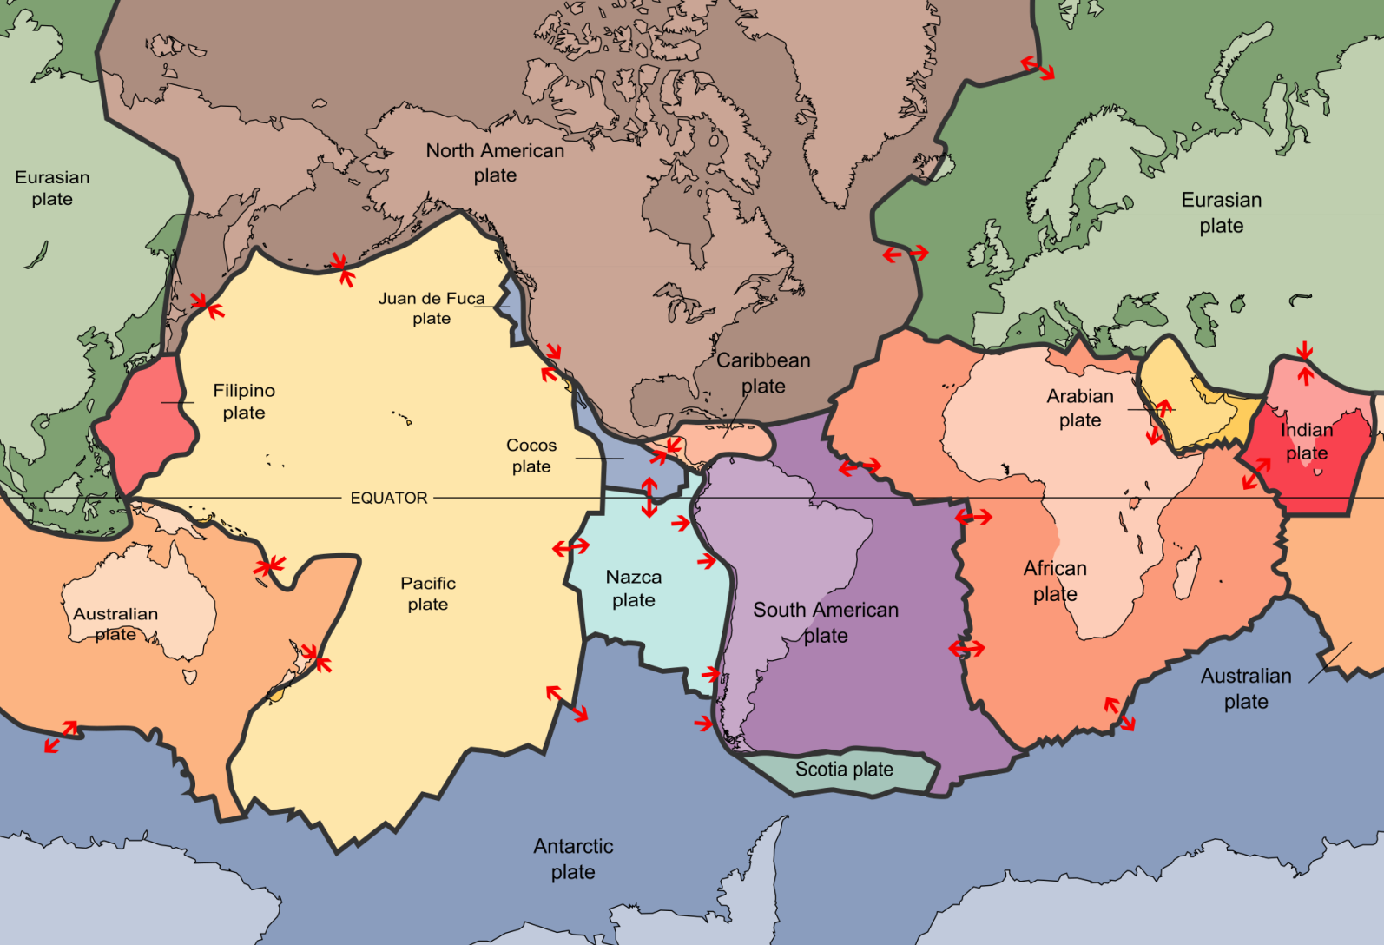
Earth’s Tectonic Plates
Notes:
Earthquakes are results of sudden release of energy from frictions between Earth’s tectonic plates

Slide 4
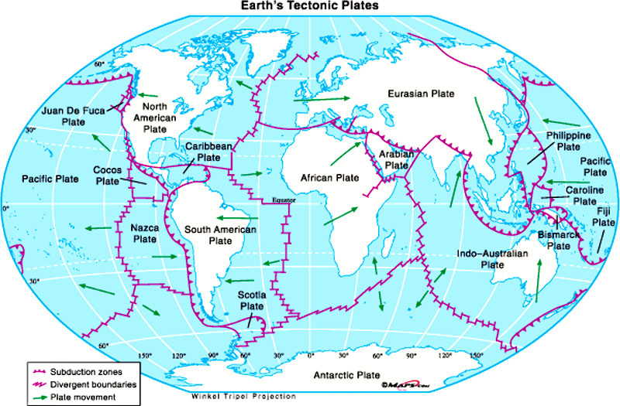
Earth’s Tectonic Plates

Slide 5

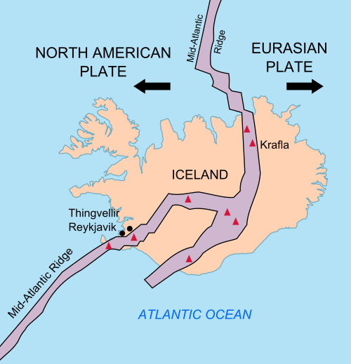

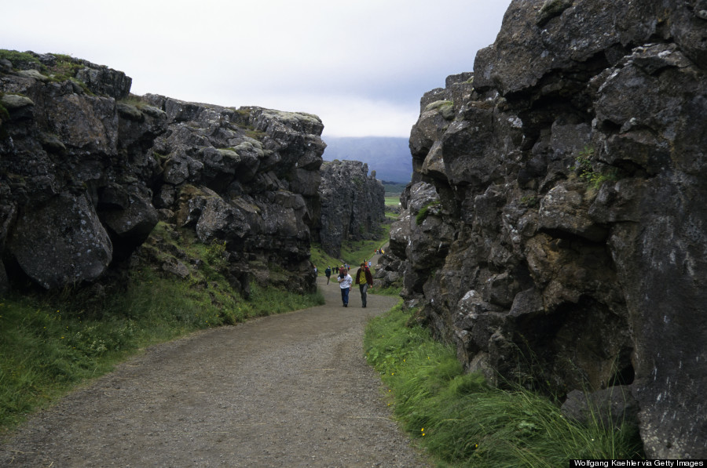
North-American meets Eurasian Plates
Notes:
Earthquakes can be destructive, but occasionally yields beautiful landscapes …

Slide 6

How do we measure earthquakes?
Richter Scale (1934)
measures Magnitude of an earthquake (from 0 to 10)
each measure is 10 times as powerful as the previous measure, and 32 times more energy released
Magnitude 1 releases the energy similar to the explosion from 6 ounces of TNT.
Magnitude of 8 is as much energy as detonating 6 millions tons of TNT

Slide 7
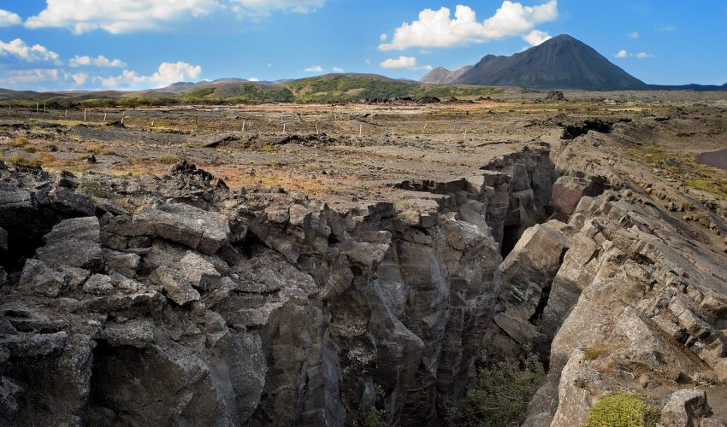
Now let’s take a look at
some fascinating data …

Slide 8
FUTURE RESEARCH / DIRECTIONS
Incorporate weather data
Research geographical data of location with higher magnitude earthquakes

Slide 9
Conclusions …
Potential correlation between earthquake depth and magnitude
No other conclusions can be drawn at the moment until further researches can be done

Slide 10
Credits / References
URLs
https://earthquake.usgs.gov
http://www.geo.mtu.edu/UPSeis/intensity.html

